Slide 1
HTN TX
Dr. Anna H. Haro
February 2023
Westside High School

Slide 2
LEARNING Objectives TEKS: §130.233.(c)(1)(A, & B) and §130.233.(c)(2)(A, B, C, F, & G) & (3)(B)
Identify prevention measures for HTN.
Explain the lifestyle modifications for tx of HTN.
Compare and contrast the different drug classes available to treat hypertension.

Slide 3
Objetivos de aprendizaje TEKS: §130.233.(c)(1)(A, & B) and §130.233.(c)(2)(A, B, C, F, & G) & (3)(B)
Identificar las medidas de prevención de la HTA.
Explique las modificaciones en el estilo de vida para tx de HTN.
Compare y contraste las diferentes clases de medicamentos disponibles para tratar la hipertensión.

Slide 4
Outline
dx
tx
px
Lifestyle modifications
Rx

Slide 5
hypertension
HTN, or high blood pressure, is the most common chronic disease in the United States, about 68 million Americans have it.
Blood pressure naturally increases as the patient ages.
The BP or blood pressure is the pressure of the circulating blood exerted against the walls of the blood vessels. Also, the vessel walls themselves exert pressure to keep blood moving against the flow of gravity.

Slide 6
hypertension
There are two numbers or two distinct measurements for BP, the systolic blood pressure and the diastolic blood pressure.​ BP = systolic over diastolic.
SBP or Systolic blood pressure = the pressure against the blood vessels when the heart is contracting (pumping blood). Reminder: the heart’s __________ are responsible for pumping blood.
DBP or Diastolic blood pressure is the pressure against the blood vessels when the heart is relaxing (filling with blood). Note: the atria fill with blood.

Slide 7
What is BP?
The BP is measured and written as two different values.
BP = SBP/DBP or systolic over diastolic.
When measuring and listening to the blood pressure sounds, the systolic will be the first sound.
When measuring the blood pressure, the moment at which the heart sounds are undetectable would be the diastolic blood pressure.
Discuss: what measurement will be higher? Is it possible for the other to be higher, ever???

Slide 8
What is BP?
Normal BP = 120/80 mmHg​ (normotensive)
HTN is when BP > 130/80 mmHg​ (hypertensive)
Low BP < 90/60mmHg​ (hypotensive)
The BP range between 120/80 mmHg and 130/80 mmHg is considered “borderline”​
Remember, BP = SBP/DBP (systolic over diastolic)​
This is NOT a fraction and it is NOT a ratio, there are two distinct measurements. You will never reduce the numbers.
Note: what unit is used to measure BP?

Slide 9
Hyper vs. hypo tension
In normal circumstances, BP increases with age.
Hypertension: Acute elevations in BP are caused by excessive fluid, vigorous exercise, pain, acute stress, or anxiety (such as white coat syndrome – what is this?). What can cause excessive fluid?
Hypotension: Acute drops in BP occur due to dehydration (although rebound hypertension can occur), shock, sepsis, blood loss, drugs, or sudden change in T. “Normal” low BP is benign, and we do not treat it, but all the others are medical emergencies. If we treat the emergency, then the BP will rise to normal.

Slide 10
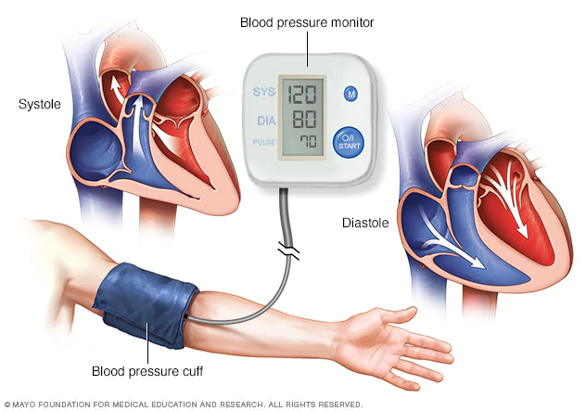
dx of HTN
Measure 2 to 3 BP readings each at three or more separate appointments before dx’ng HTN.
BP normally varies throughout the day and may be elevated during visits to the doctor (white coat hypertension).
When measuring the blood pressure, the health care professional uses a cuff, stethoscope and a sphygmomanometer or a digital BP monitor.
Image from the Mayo Clinic: https://www.mayoclinic.org/-/media/kcms/gbs/patient-consumer/images/2018/05/11/14/58/blood-pressure-monitor-8col-3559308-001-0.jpg

Slide 11
PX of hypertension
HTN is the most common chronic disease in the United States, about 68 million Americans have it.
px (prophylaxis)
preventing HTN is the first line of tx
Stop/quit smoking and vaping
Improve diet – a low ____________ diet best helps to reduce blood pressure.
Begin exercising – recall the AHA recommendations. 150 minutes per week of moderate intensity.

Slide 12
tx
After the pt is dx’ed with HTN, begin lifestyle modifications.
What do you think are the modifiable risk factors?
Lifestyle modifications will be combined with Rx medication(s). Most patients take 2 to 3 different drugs for HTN.

Slide 13
tx – lifestyle modifications
Modifiable Risk factors include:
Smoking
Overweight or obese
Excessive alcohol use
Physical inactivity
Uncontrolled DM
Diet = too much salt or sodium (NaCl)
Illegal drug use (cocaine = vaso-constriction)

Slide 14
tx of HTN: Rx drug classes
Diuretics
ACE – angiotensin converting enzyme inhibitors
ARB – angiotensin receptor blockers
BB – beta blockers
CCB – calcium channel blockers
Alpha blockers
Direct vasodilators
Several other classes, about 200 drugs in all to tx HTN
****Major Grade Project Option 1:you will create a HTN drug treatment flipbook.

Slide 15
Tx of HTN: Rx drug classes
Diuretics – water pills, MOA: they make pts frequently urinate
A. Thiazide diuretics:
ex. Hydrochlorothiazide or HCTZ is the first line for MOST pts (except those with a sulfa-allergy).
B. Potassium sparing diuretics (these work in the K-Na pump in the kidney):
ex. Spironolactone
C. Loop diuretics – these drugs work in the Loop of Henle in the kidneys to expel more water and urine:
ex. Lasix® or furosemide
Discussion question: For all diuretics, what time of day should these NOT be taken???

Slide 16
tx of HTN: Rx drug classes
2. ACE – angiotensin converting enzyme inhibitors or frequently called ACE-inhibitors.
MOA: promote vasodilation of blood vessels by inhibiting the formation of angiotensin 2 in the kidneys
2nd line tx for most pts – can be combined with HCTZ
Ex. lisinopril, enalapril, ramipril, captopril, benazepril, trandopril, (Enalaprilat® is IV enalapril)
AE (adverse events or side effects): dry cough, HA, dizziness, fatigue, angioedema – facial swelling. For most pts, they tolerate ACE-I very well.
What other condition do these drugs tx?

Slide 17
tx of HTN: Rx drug classes
3. ARBs – angiotensin receptor blockers
MOA: ARBs block the angiotensin II receptors (similar overall effect as the ACE-i) thus causing vasodilation of blood vessels.
Ex. valsartan, irbesartan, candesartan, olmesartan, losartan, telmisartan
Can combine with diuretics but not with ACE
Note: most manufacturers of valsartan have been recalled within the past 2 years.
Positive effects, in addition to decreasing BP, ARBs show renal-protective effects, and can assist with preventing weight gain.
AE: HA, dizziness, fainting, fatigue, V/D, leg swelling
For most pts, the benefits outweigh the risks.

Slide 18
tx of HTN: Rx drug classes
4. BB – beta blockers
MOA: Block the Beta-adrenergic receptors (block the effects of adrenaline), decrease the heart rate and the force of contraction, thus lowering BP.
Ex. Metoprolol, atenolol, and more.
AE: bradycardia – what does this medical term mean?
Note: we will discussed these drugs for tx of AMI

Slide 19
tx of HTN: Rx drug classes
5. CCB – calcium channel blockers (calcium antagonists)
MOA: Block the calcium channels in cardiac smooth muscle and in vascular smooth muscle cells, decreasing the force of contraction in the heart and arteries. Two types: dihydropyridines and non-dihydropyridines
Ex. Diltiazem, verapamil, nifedipine, amplodipine, felodipine
AE: bradycardia vs. tachycardia, headache, dizziness
Note: we will discuss these drugs for tx of AMI
Note: CCBs are sometimes preferred in African Americans (fewer SE than ACE and ARBs)

Slide 20
tx of HTN: Rx drug classes
6. Alpha blockers (ex. doxazosin, prazosin, tamsulosin, Flomax®) – these drugs also treat BPH or benign prostatic hyperplasia
7. Direct vasodilators (ex. hydralazine, nitroprusside)
8. Several other classes, about 200+ drugs to tx HTN

Slide 21
Questions
What questions do you have???
Send questions via email, Remind, or TEAMs chat. Anna.Haro@Houstonisd.org

